Slide 2
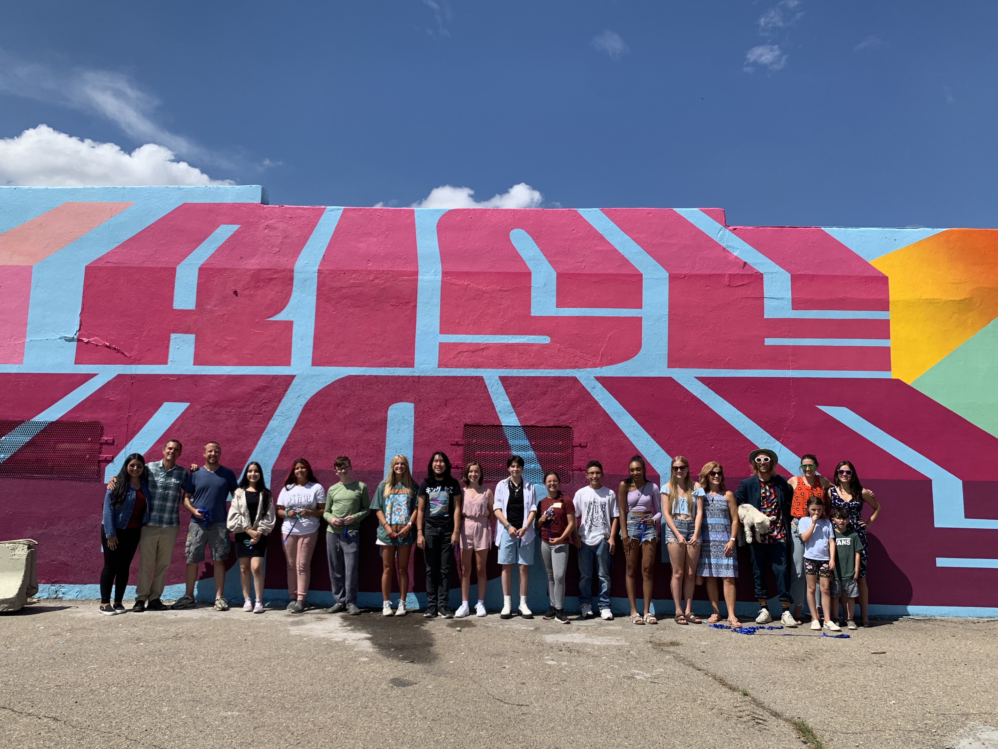
“Rise Above Colorado is a statewide prevention organization that measurably impacts teen perceptions and attitudes about the risks of substance misuse to help youth make healthy connections, decisions and change.”

Slide 3
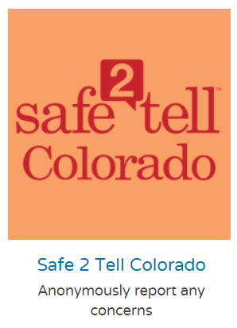
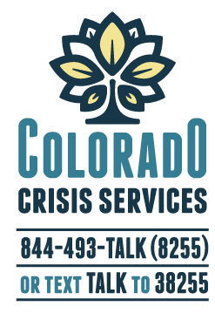

Slide 4
Objectives
REVIEW recent data on teen substance misuse
EXPLORE connection between perceptions, attitudes & behaviors
BUILD critical thinking skills to better interpret the world around us with an open-mind
DISCUSS hopes & concerns about Colorado teen substance misuse
PLAN ways to correct misperceptions and rise above substance misuse

Slide 5
What percentage of HS youth in CO have NOT used alcohol in the past 30 days?
a. 76%
b. 71%
c. 68%
d. 55%
Notes:
2022: Rise Above Colorado Youth Survey: 76% have not used, 24% have used
2021 HKCS: approx. 75% have not used, 24.7% have used

Slide 6
What percentage of HS youth in CO have NOT used marijuana in the past 30 days?
a. 93%
b. 83%
c. 73%
d. 63%
Notes:
2022: Rise Above Colorado Youth Survey: 83% (have not used)
2021 HKCS: 13.3% have used, which means approx. 87% (have not used)

Slide 7
But is this information REALLY true?!?
Despite occasional pushback, this information is accurate and well documented.
“Yeah but teens lie…” Some teens do indeed mislead, but there are failsafe measures to identify and remove dishonest participation. A large sample size helps ensure results are accurate. This data is consistent with many other surveys and studies.
Yeah but this is just propaganda…” Do we have an agenda? Yes! We are unapologetically working to empower teens to help them stay healthy and connected. But this requires accurate and honest conversations - not propaganda.
“Yeah but all my friends smoke pot…” Two things can be true at once but it’s important to take a wider view, and confront something called confirmation bias, which is interpreting new evidence to confirm existing beliefs.
Notes:
Teens Lie: Anonymous, so there isn’t an incentive to lie, administered remotely, which is a proven technique to ensure responses are more accurate. Having a large sample size also helps with accuracy, and ensures the results are representative of the state and local regions.
Two things can be true at once/the same time: if you smoke pot, chances are pretty good that your friends do too, this study validates exactly that point, that people who use drugs are far more likely to hang out with people who also do drugs, and because of that, to them, it looks like most people are like them and their friend group, this is one of the main reasons for doing this study, to show teens that not everyone is like them.
Propaganda: Yes, we have an agenda by doing this research, but it’s not propaganda. This data is YOUR data, it’s not fake news. The information in this research is what Colorado’s youth told us. We didn’t make it up – it came from teens 13-17 years of age, all selected at random from across the state. And what is our agenda? Our agenda is to help youth lead healthy lives, one that allows them to grow up to become the kind of adults they want to become, making the kind of choices early in life that will let them achieve that future. That’s our agenda. Youth who use drugs often do so out of peer pressure or as a coping mechanism to things like stress. And sometimes, their drug use gets to a point where it begins to define who they are and what they do. We know that 90% of all addictions begin with use in the teen years. Our agenda is to empower teens to lead a healthy life, free of addiction. Full stop.

Slide 8
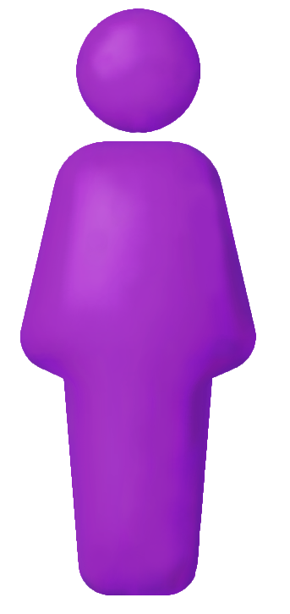
Confirmation Bias
Circle of friends
Circle of friends
We may have friends or know peers who use, making us think that most people do. However, if we look at the bigger picture, far fewer people than we think do.
Fewer than 1 out of 5 high school-aged students (17%) recently used marijuana
But teens believe that more than twice that many have (37%)
Everyone else
Have Used
Have Not Used

Slide 9
How do you define PERCEPTION?

Slide 10
Why do we need accurate perceptions?

Slide 11
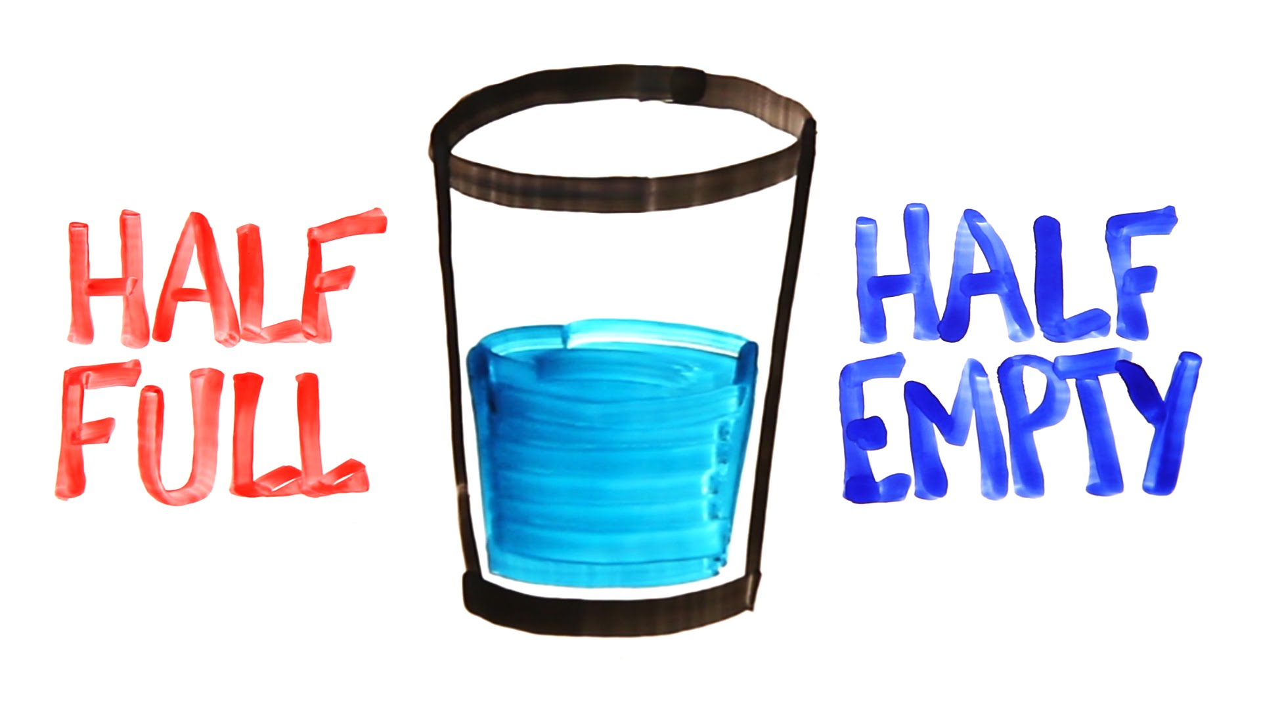
Where do our perceptions come from?

Slide 12
How does social media impact our perceptions?
Notes:
Who is the customer on social media? Flip the script – you’re actually the product!

Slide 13
What are some tips to help us become healthier consumers of social media?

Slide 14
Step 1:
OBSERVE
Step 2:
QUESTION
Step 3:
INTERPRET

Slide 15
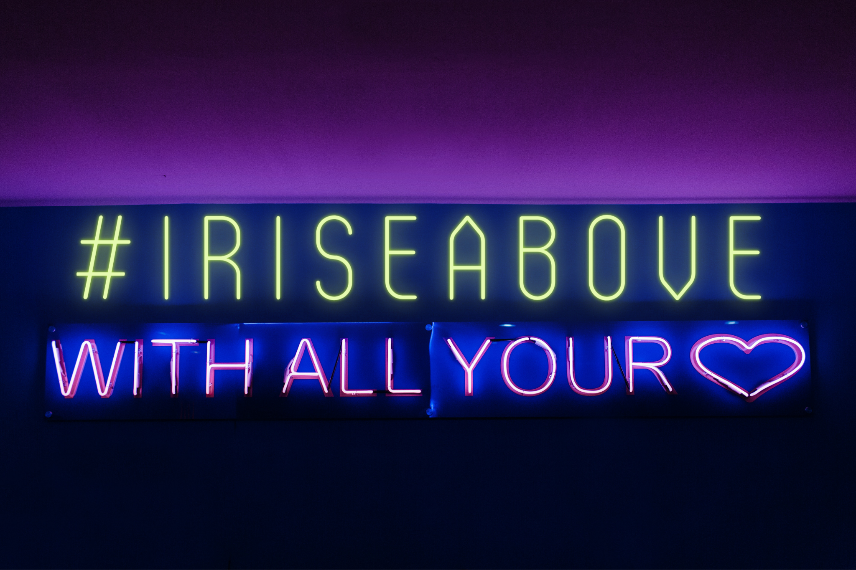
What is the Rise Above Colorado Youth Survey?

Slide 16
 | Healthy Kids Colorado Survey | Rise Above CO Youth Survey
Age | Grades: 6-8th & 9-12th | 12-17 years old
Last year of collection | 2021 | 2022
Data collection method | Online (at school, in a classroom) | Online (outside of school)
Sample size | 53,000 students from randomly selected middle & high schools | 700+
Sampling design | Representative of CO public middle/high school enrollment | Representative of Census data by county
Areas of focus | Comprehensive Health & Wellness | Behavioral Health with a focus on substance use
Notes:
Ask if some students recall taking Healthy Kids Colorado Survey in school. HKCS is long and asks about health broadly – from seatbelts, to sexual health and wellness, to drugs. RAC Youth Survey just looks at substance use and factors that can contribute to use.
You see some differences in data from each survey; however overall trends are comparable indicating that there is validity in both.
HKCS data tends to see higher rates, some of which is due to their sample being older. They mainly report on their high school data alone whereas the Rise Above Colorado Youth Survey reports on data from 12-17 year olds. Rise Above CO doesn’t even survey 18 year olds.
Note: critical thinkers, esp teens, will doubt the validity of the data. The fact that multiple surveys are finding similar results lends much credibility. However, with self-report data, there’s always that limitation of participant honesty and for sure, there’s always a few but they usually aren’t enough of them to sway the results much at all.

Slide 17
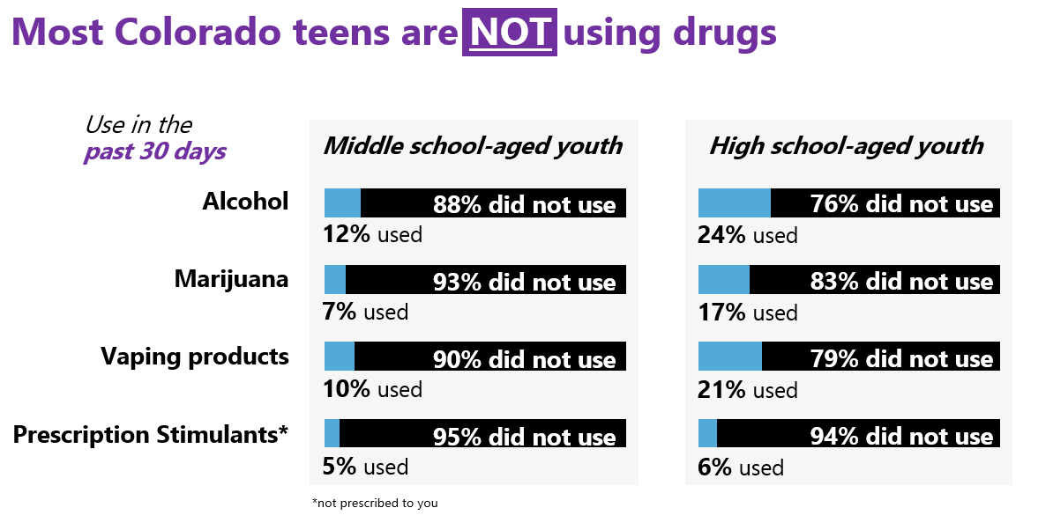

Slide 18
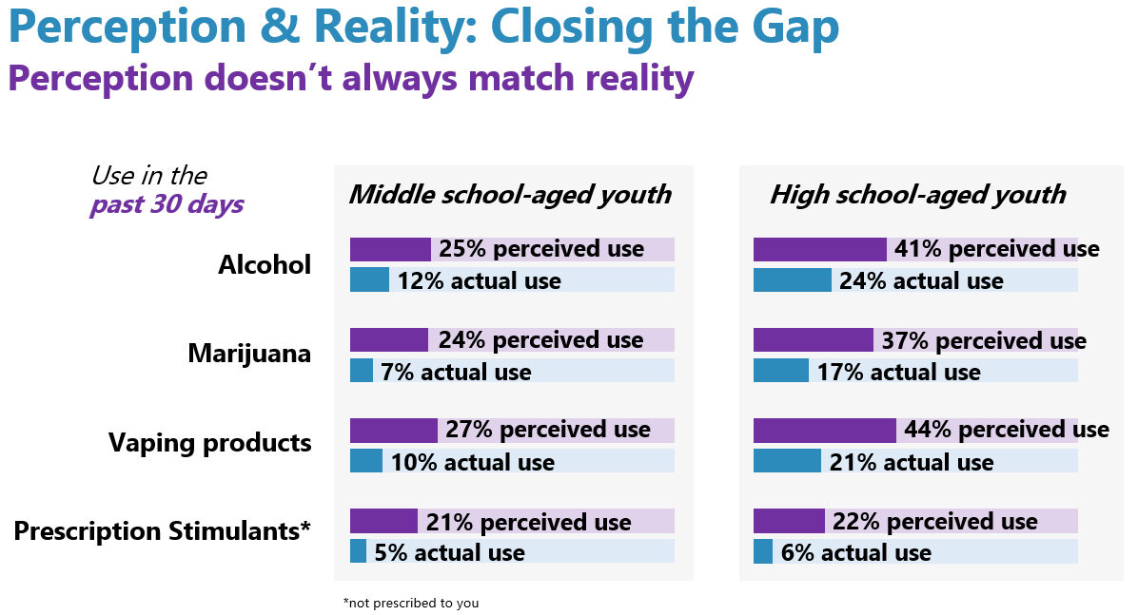

Slide 19
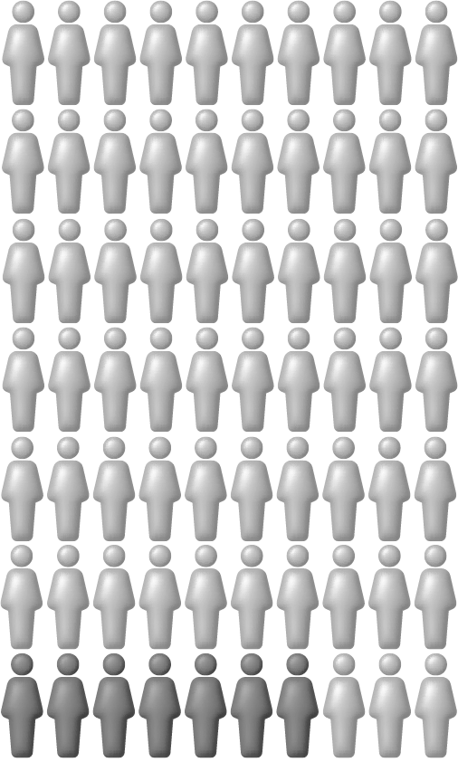
Perception does not always match reality
Marijuana Overestimation & Actual Use
83%
of teens in high school
have not used marijuana
in the past 30 days
Teens believe 37% have used it
High School teens believe more than twice as many teens use marijuana than actually do.
When only 17% have

Slide 20
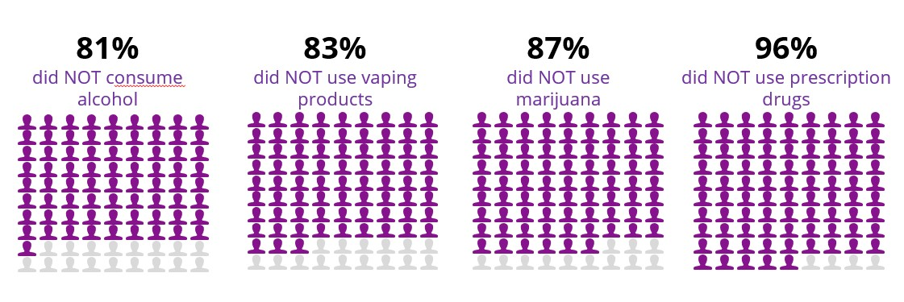
HOPE & CONCERN:
In the past 30 days, the percentage of CO teens who…
19%
consumed alcohol
17%
used vaping products
13%
used marijuana
4%
used prescription drugs

Slide 21
Perception,Reality, & Behavior
"The Gap" or misperception

Slide 22
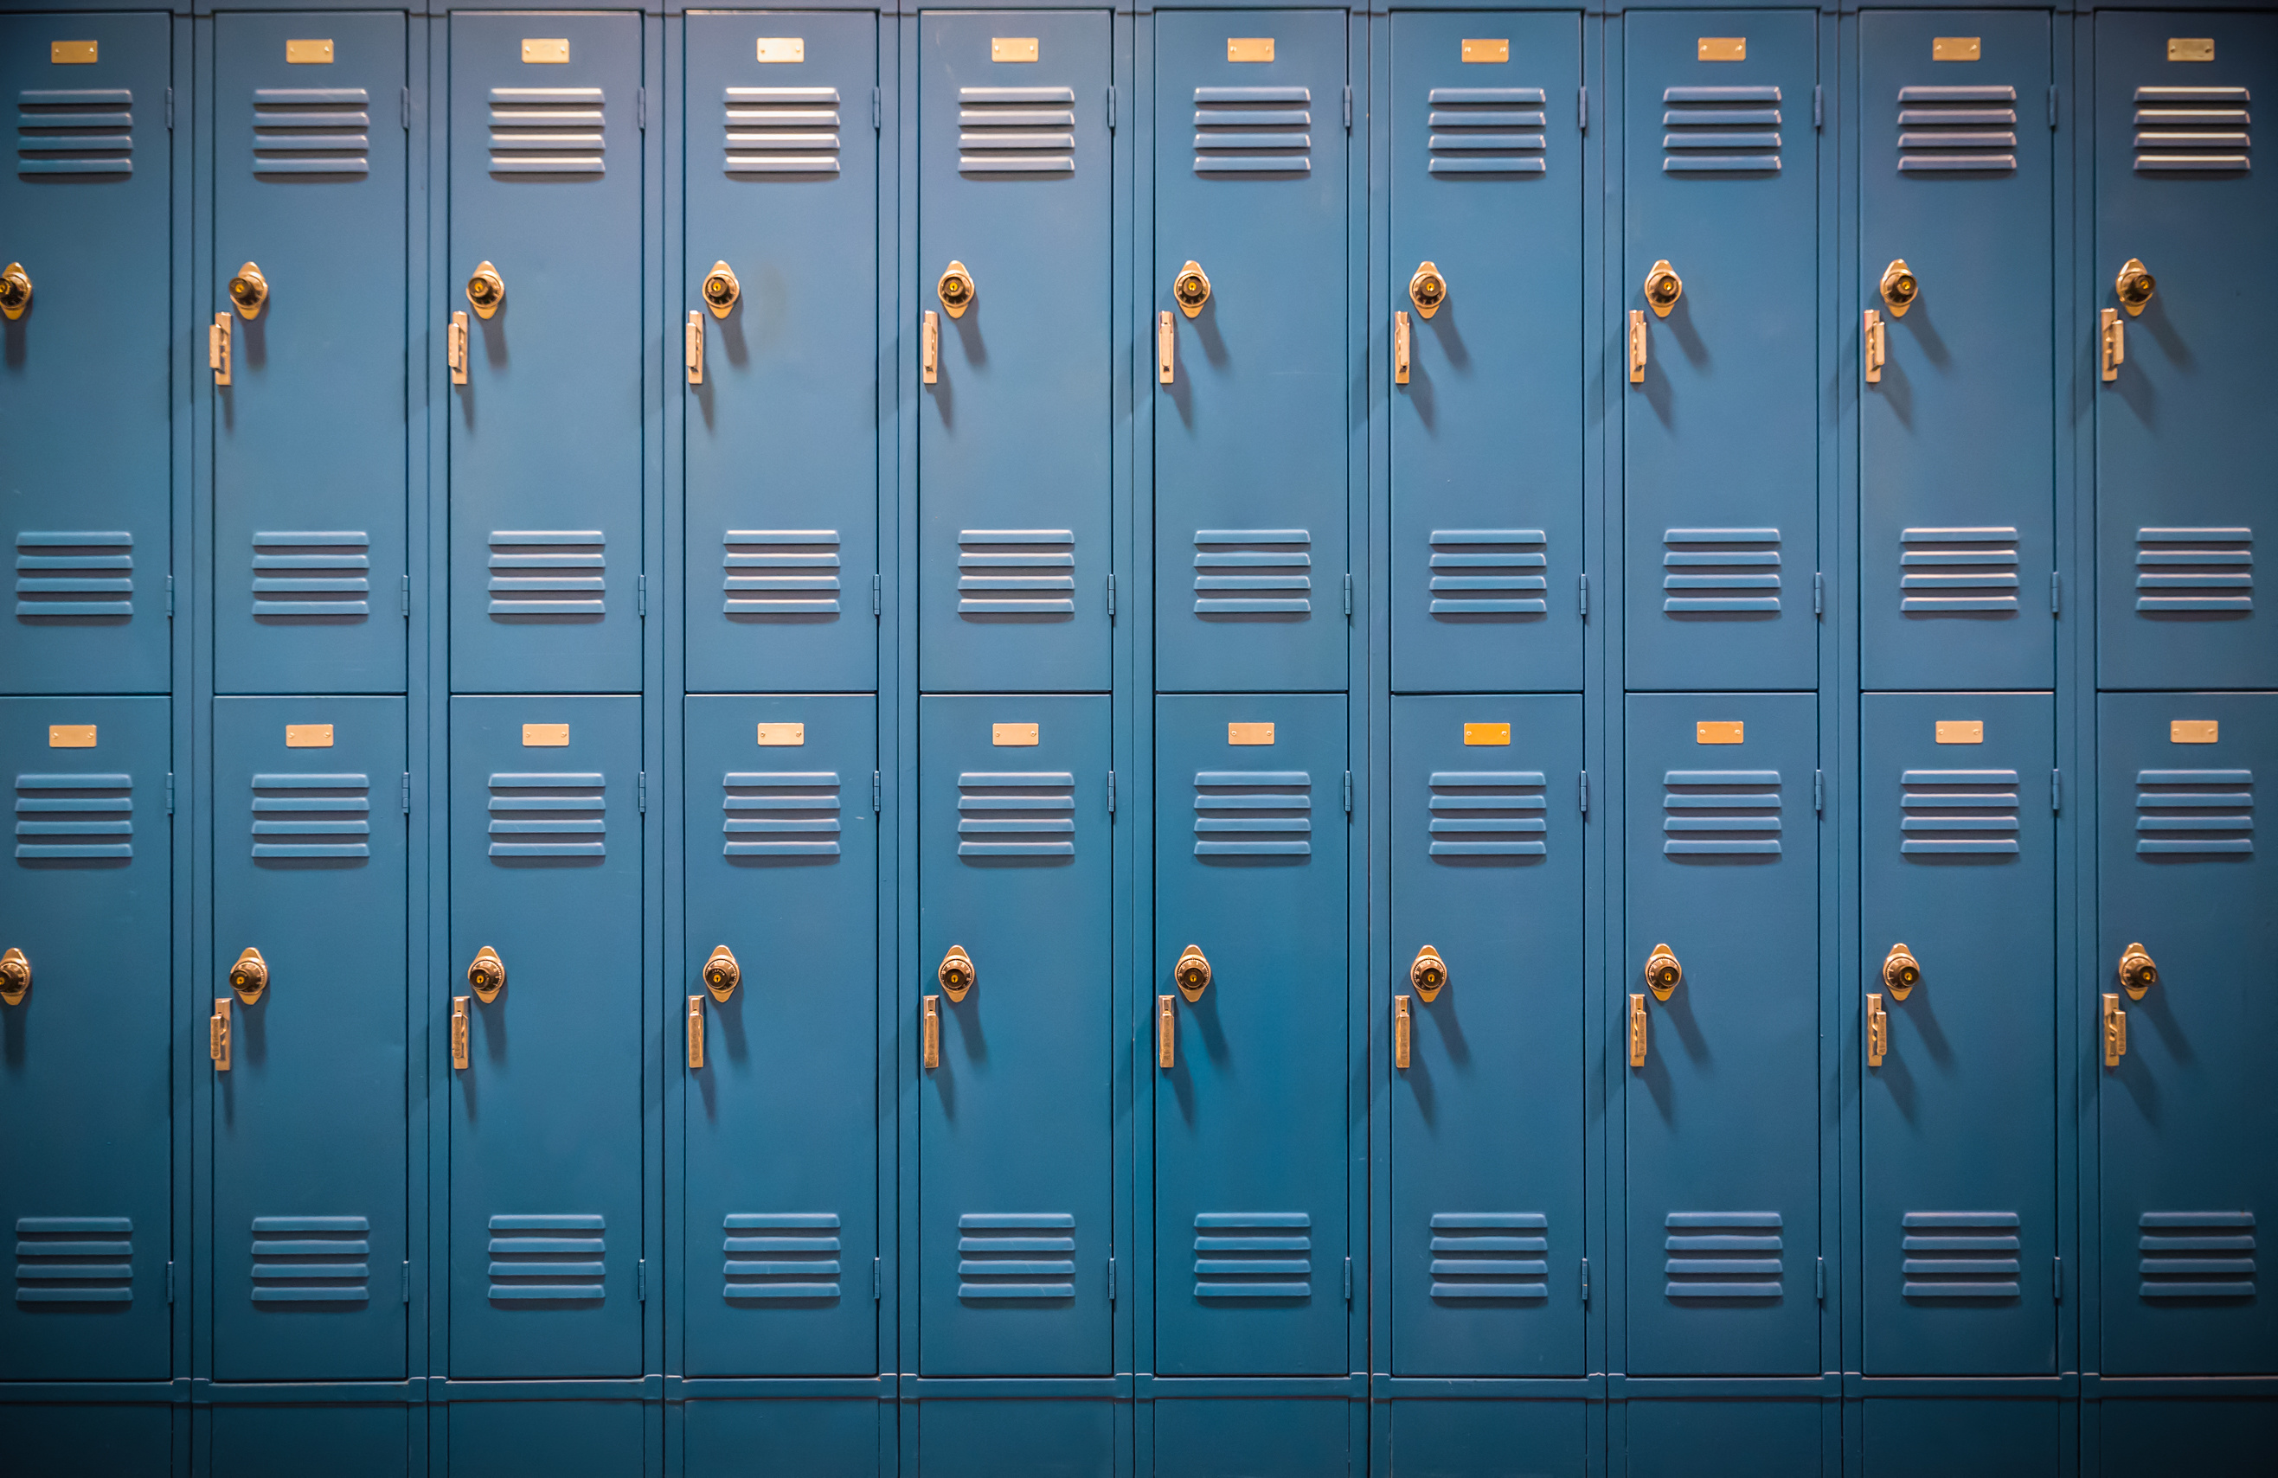
What factors
contribute to teens
misusing substances?

Slide 23
What HOPES & CONCERNS do we have?
Using Observation, what knowledge and skills can we focus on to help prevent ourselves and others from slipping into substance misuse?
What Questions can we ask of ourselves and others to ensure this knowledge and/or these skills are effective?
How will we Interpret and build on our success?

Slide 24
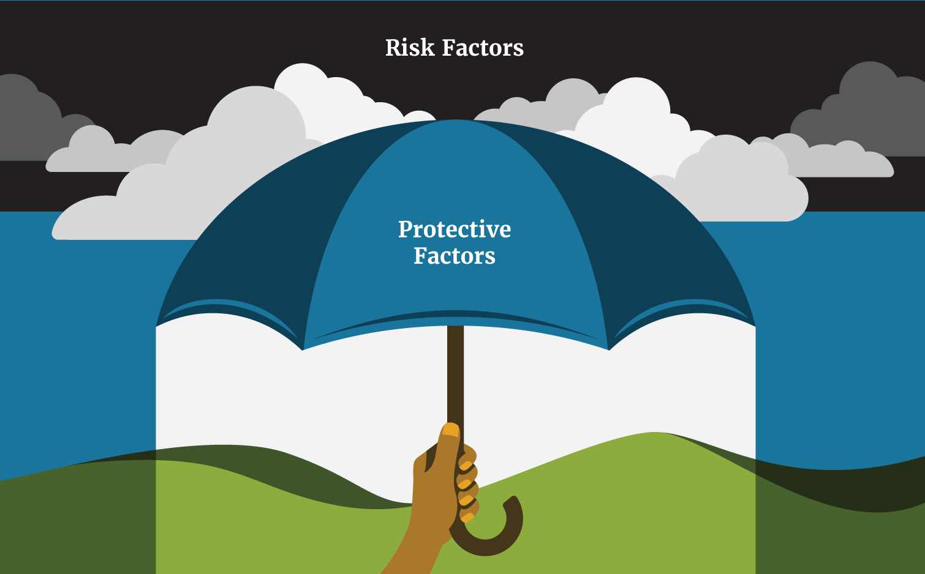
Positive connection with family, peers & community
Positive coping, stress, & management skills
Trusted adults
Hobbies & interests
Goals for future

Slide 25
What actions can YOU take to correct misperceptions among your friends, peers, family and community?

Slide 26
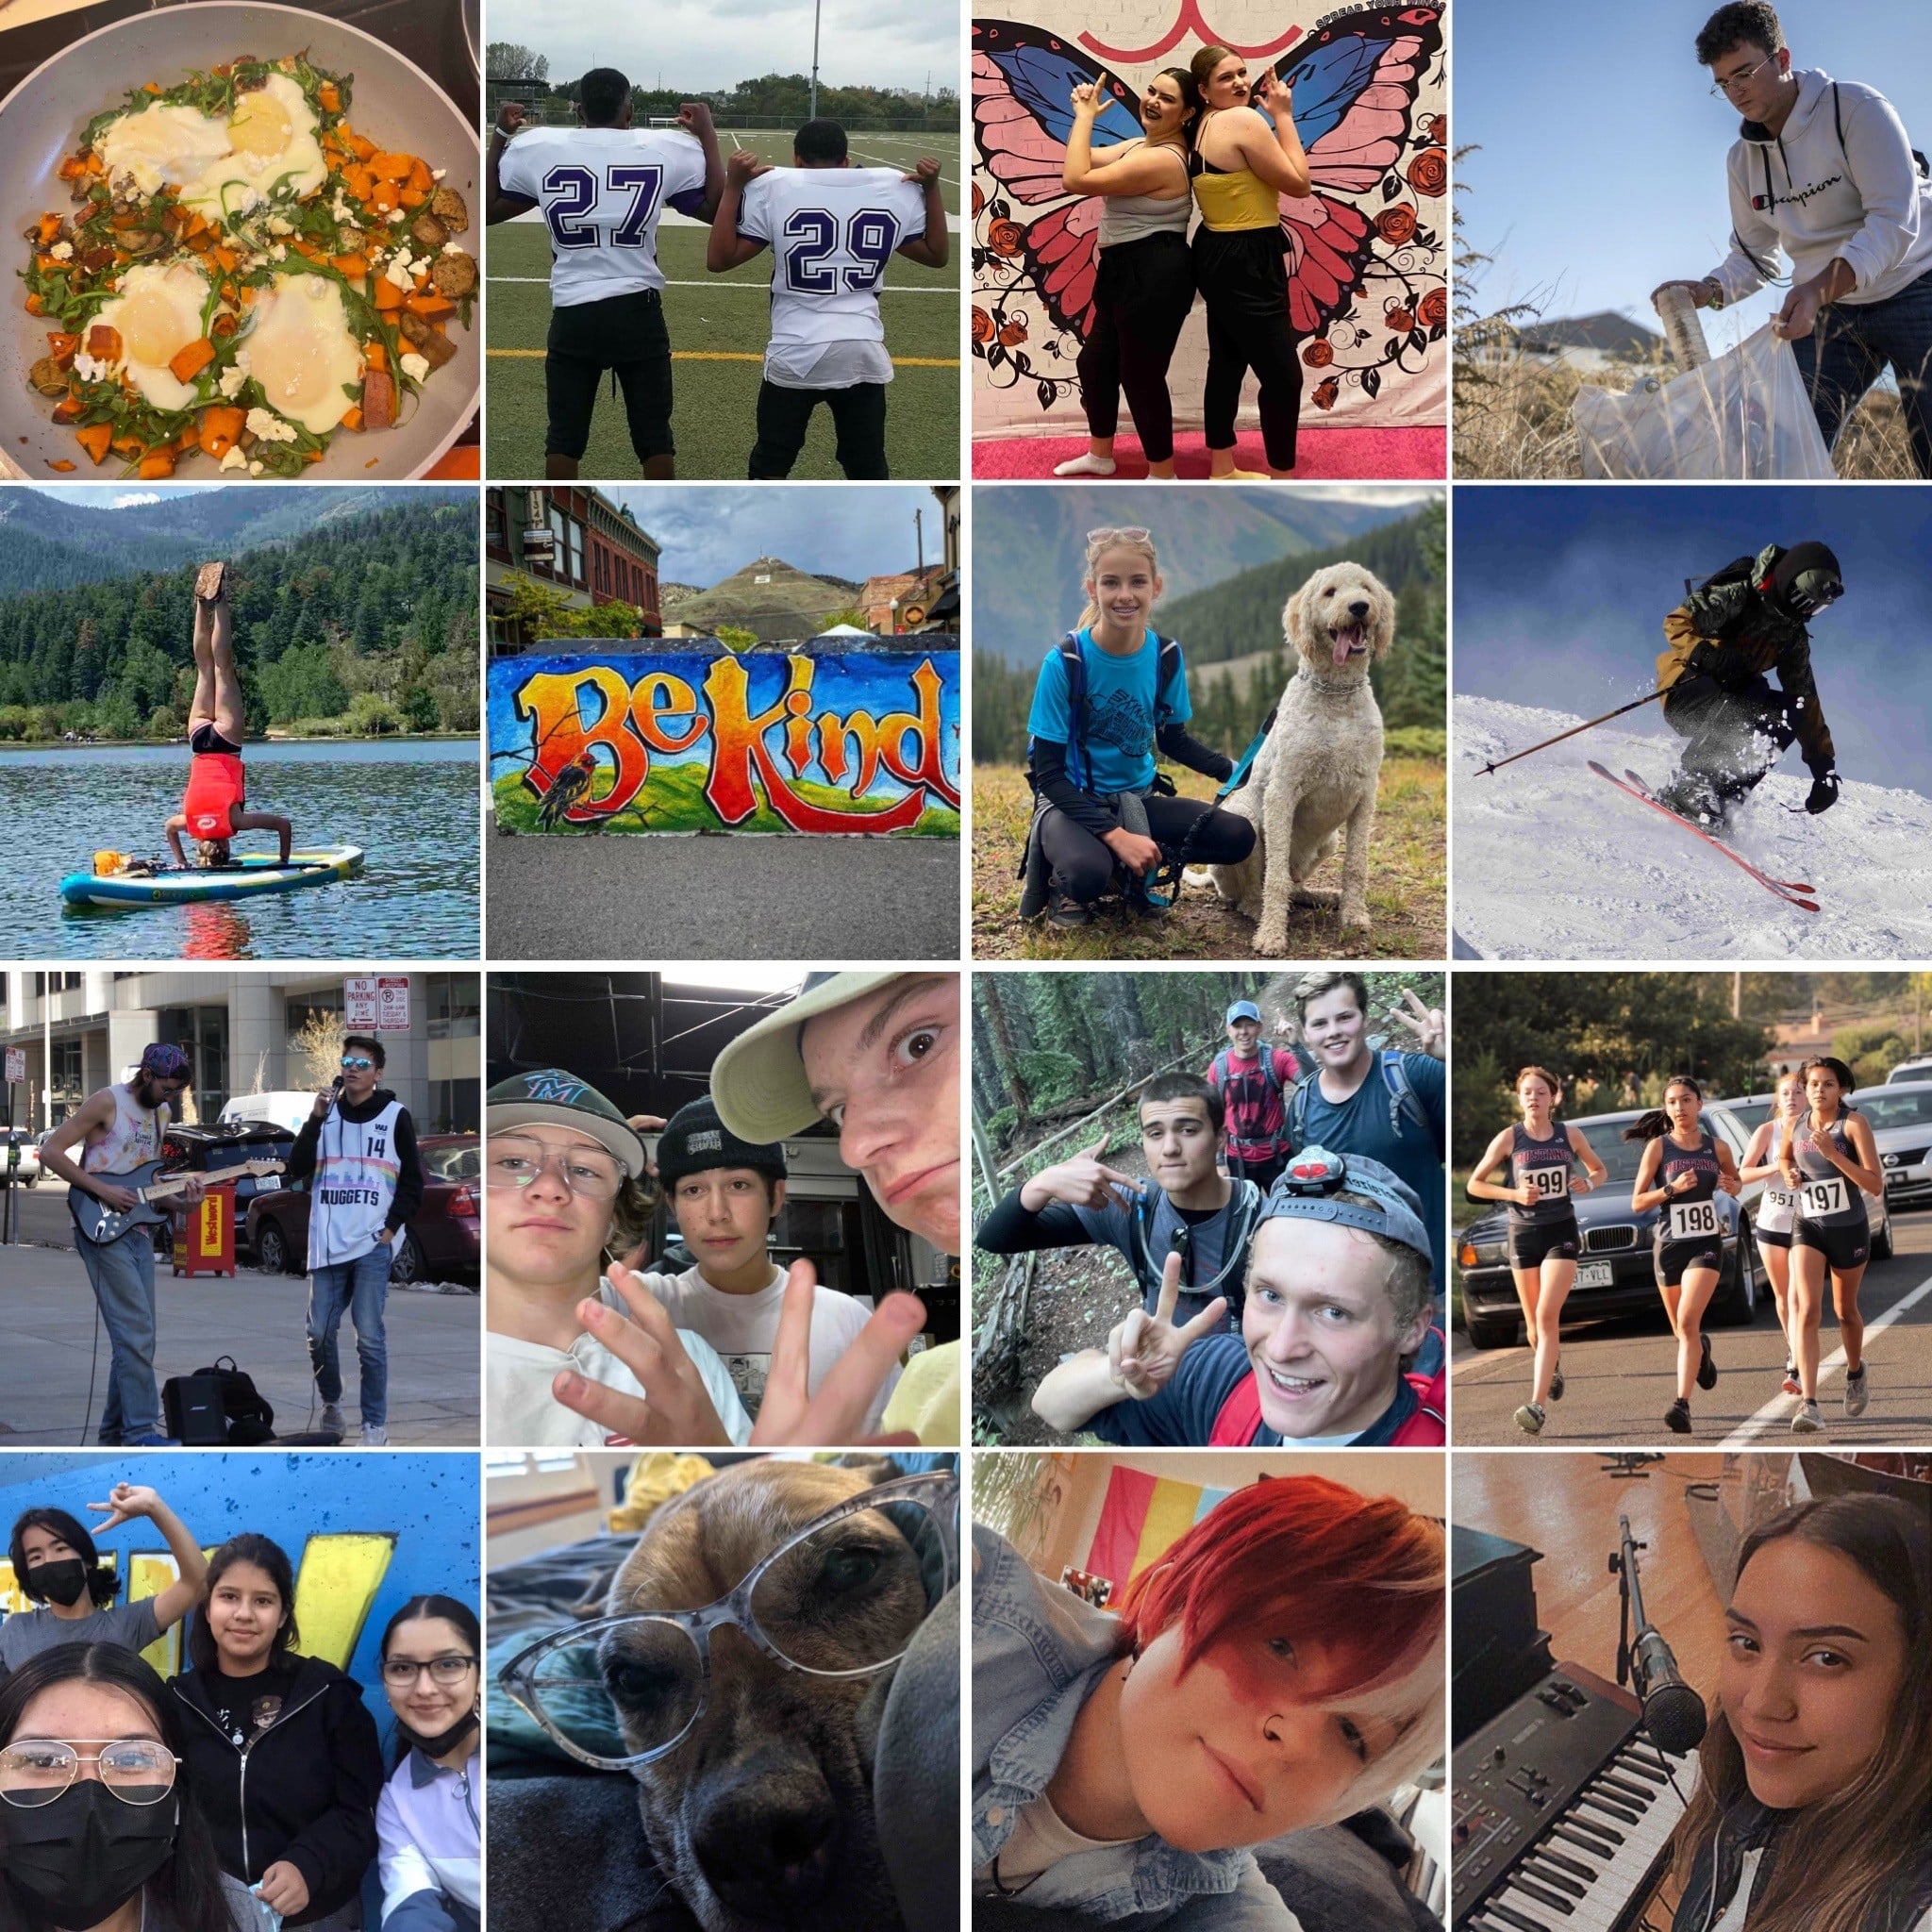
Check out youth resources & campaign updates: www.IRiseAboveCO.org
Connect with
Rise Above Colorado
on social media:
#IRiseAbove
@riseaboveco

Slide 27
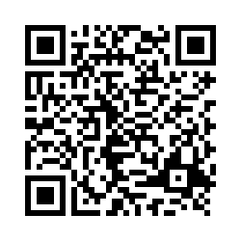
Please complete Closing The Gap Post-Survey!

